Slide 1
Knowledge Graph Completion With Graph Neural Networks
Jae F. Muzzin

Slide 2
Introduction
A knowledge graph can be represented as a set of (subject, relationship, object) triples, eg,
(Maroon, Shade_of, Red)
The task of knowledge graph completion aims to infer new triples based, on facts established from existing triples.
A graph neural network (GNN) can be used to learn patterns in the knowledge graph which can be used to predict new triples.

Slide 3
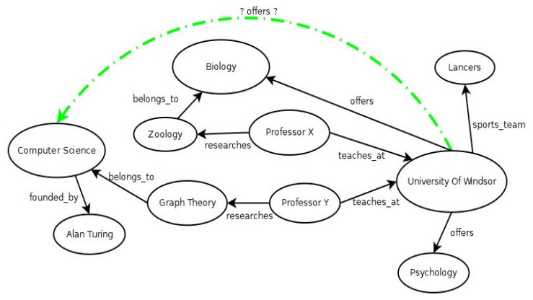
Example Knowledge Graph

Slide 4
Open Source Knowledge Graphs
Wikidata
Freebase
Wordnet
Nell
Theographic

Slide 5
Graph Neural Network
In KG link prediction, GNN acts as a subgraph classifier function
Given a proposed knowledge graph triple and its related subgraph, the GNN will determine the likelyhood score of the triple existing in the knowledge graph.

Slide 6
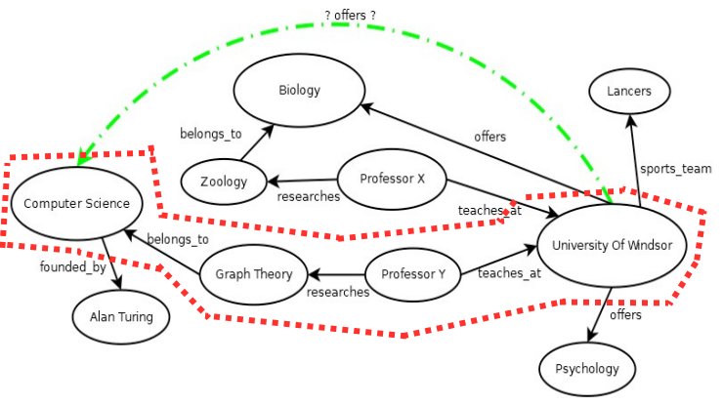
Enclosing Subgraph

Slide 7
Subgraph Extraction – Two Approaches
Include all connecting paths which are shorter than some h hops.
Include connecting paths of any length, up to some constant K
In either case, the model is only able to train strictly on information derived from a subgraph of two target nodes.

Slide 8
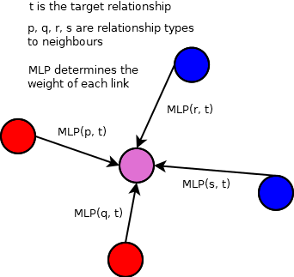
GNN – How it works

Slide 9
GNNs
The GNN can make predictions without any input from “features” of the graph nodes.
Embedding features in the GNN can improve results
Knowledge graphs entities do not contain
We can improved to the model by adding a feature vector to each node which contains topological information about the node and its subgraph neighbors.

Slide 10
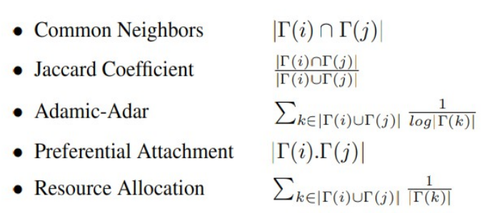
PLACn “Features”

Slide 11
The PLACN features are derived from the complete graph. This means they contain
information about the nodes in context of the knowledge
graph, which is not possible to include in the subgraphs.

